Slide 1

PAPER PRESENTATION ON
BLIND ASSISTANCE SHOES
PRESENTED BY :-
SIDDHARTH G. GUPTA
DEVESH A. KHANZODE

Slide 2
STATISTICAL SURVEY ON BLIND POPULATION IN WORLD BY WHO (WORLD HEALTH ORGANIZATION)
According to survey of WHO (World Health Organization) held out in 2011 we come to know that in world about 1% of the human population is visually impaired and amongst them about 10% is fully blind.
Globally, it is estimated that approximately 1.3 billion people live with some form of vision impairment.
India is now home to the world's largest number of blind people with 15 million.

Slide 3
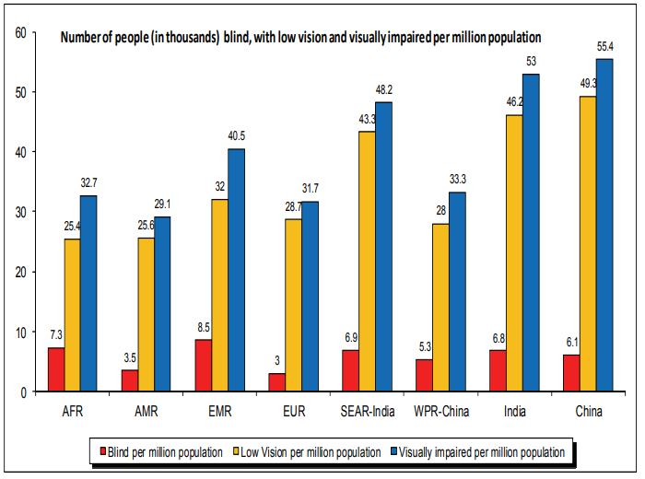
STATISTIC DATA OF BLIND POPULATION IN WORLD

Slide 4
INDEX
INTRODUCTION
BLOCK DIAGRAMS
HARDAWARE MODULE
FLOW CHART
STEPS TO USE THE PRODUCT
ADVANTAGES
DISTADVANTAGES
FUTURE SCOPE
CONCULSION
REFERENCE

Slide 5
1. INTRODUCTION
This Shoes is designed for the person which are facing the vision problem (fully blind or partially blind).
Shoes will provide the information about the obstacle on the way and assists the right path to the user.
Shoes are also give the information about the surrounding condition.
This technology can be used across the world for the visually impaired people.

Slide 6
2. BLOCK DIAGRAM
LEFT SHOE
RIGHT SHOE
BLUETOOTH AS GOOGLE ASSISTANCE
VIBRATION SENSOR
VIBRATION SENSOR
PANIC BUTTON
ULTRASONIC SENSOR
(FRONT)
WATER SENSOR
MOTION SENSOR
ULTRASONIC SENSOR
(RIGHT)
GSM
Arduino Uno
(ATmega328P)
Arduino Uno
(ATmega328P)
GPS
VIBRATION SENSOR
VIBRATION SENSOR
FIRE SENSOR
LDR SENSOR
ULTRASONIC SENSOR
(BACK)
VIBRATION SENSOR
VIBRATION SENSOR

Slide 7
3. HARDWARE MODULES
Arduino Uno (ATmega328P)
Ultrasonic Sensors
Vibration Sensor
Fire Sensor
LDR Sensor
Water Sensor
GSM Module
GPS Module
Motion sensor
Bluetooth

Slide 8
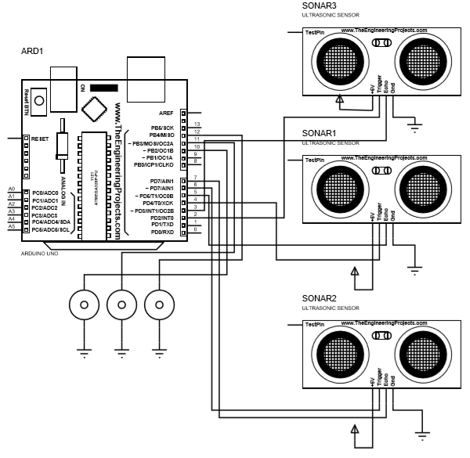
3.1 RIGHT SHOE

Slide 9
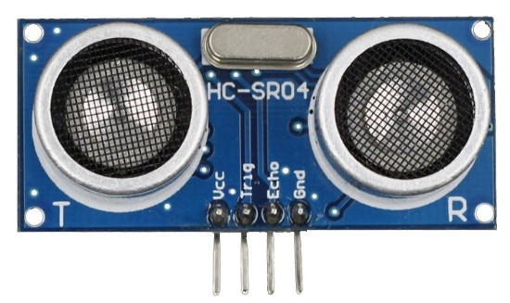
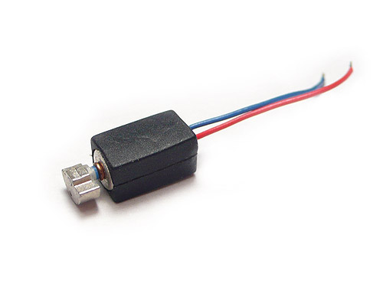
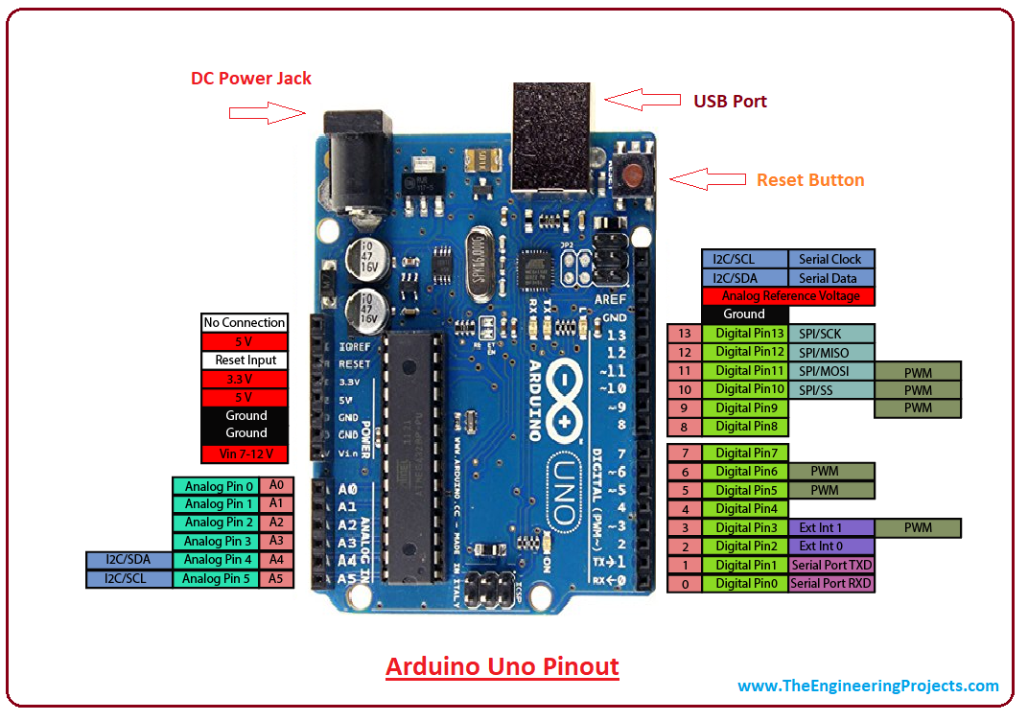
ULTRASONIC SENSOR
VIBRATION MOTOR
Arduino Uno
(ATmega328P)

Slide 10
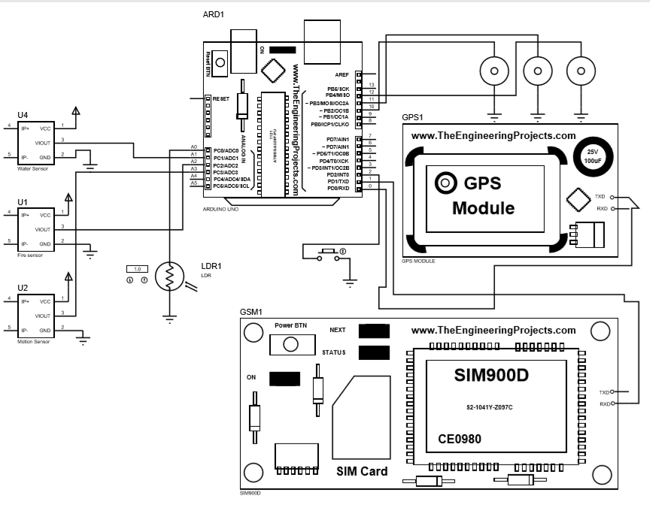
3.2 LEFT SHOE

Slide 11
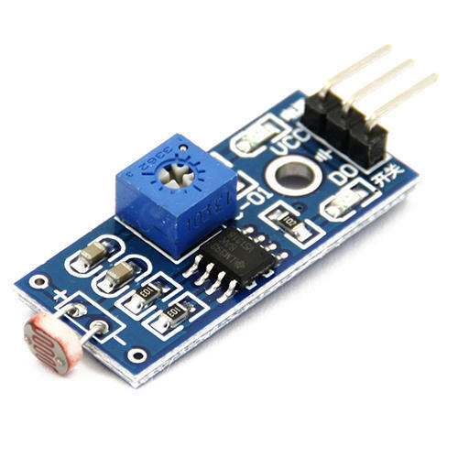
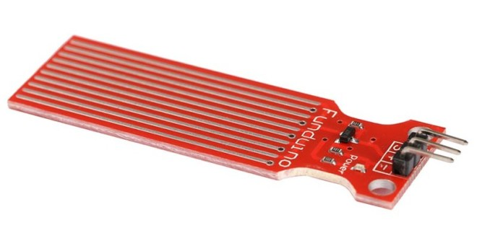
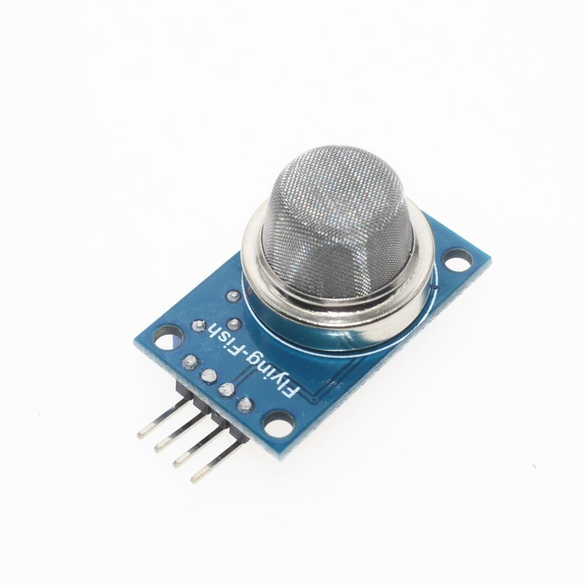
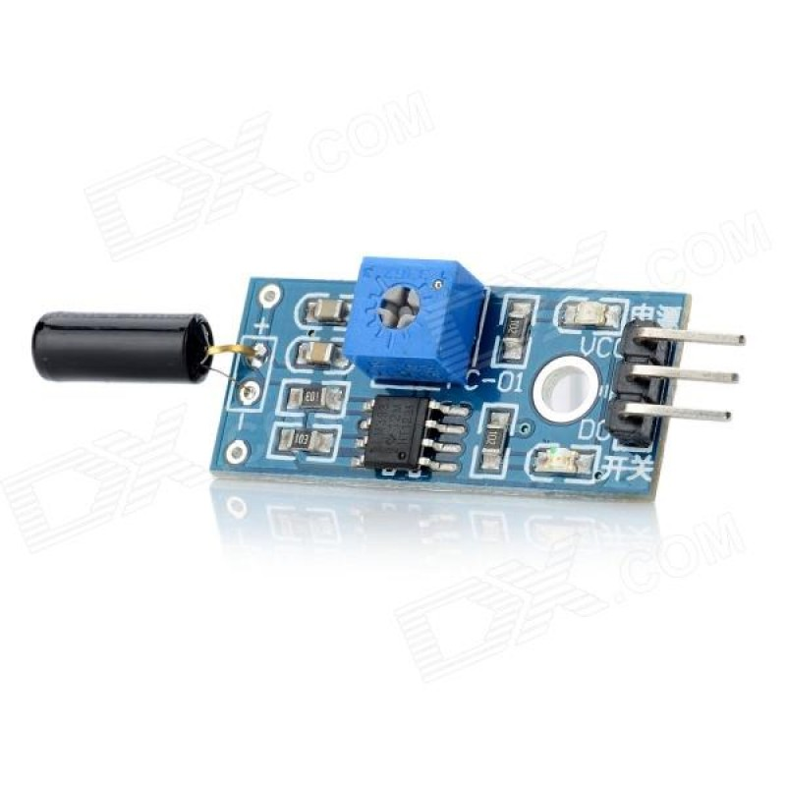
LDR SENSOR
WATER SENSOR
FIRE SENSOR
MOTION SENSOR
VIBRATION MOTOR

Slide 12

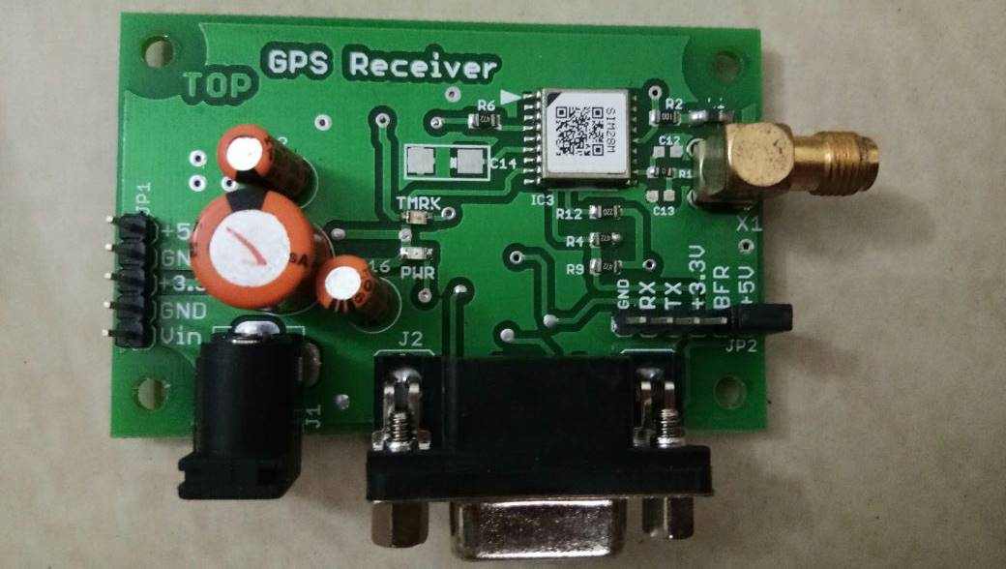
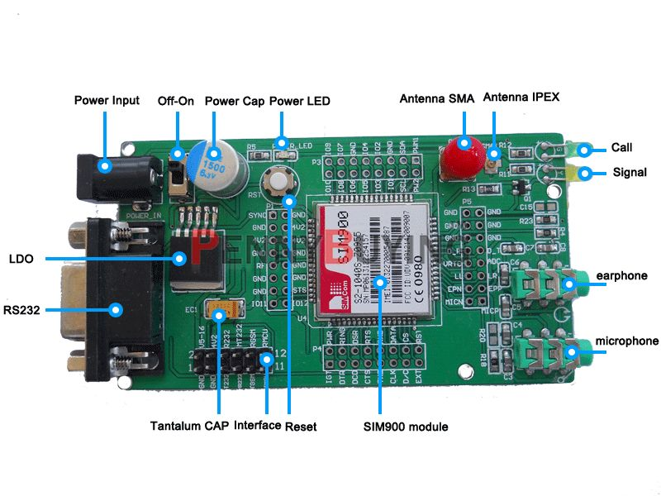
PANIC BUTTON
GSM (GLOBAL SYSTEM FOR MOBILE COMMUNICATION) MODULE
GPS (GLOBAL POSITIONING SYSTEM) MODULE

Slide 13
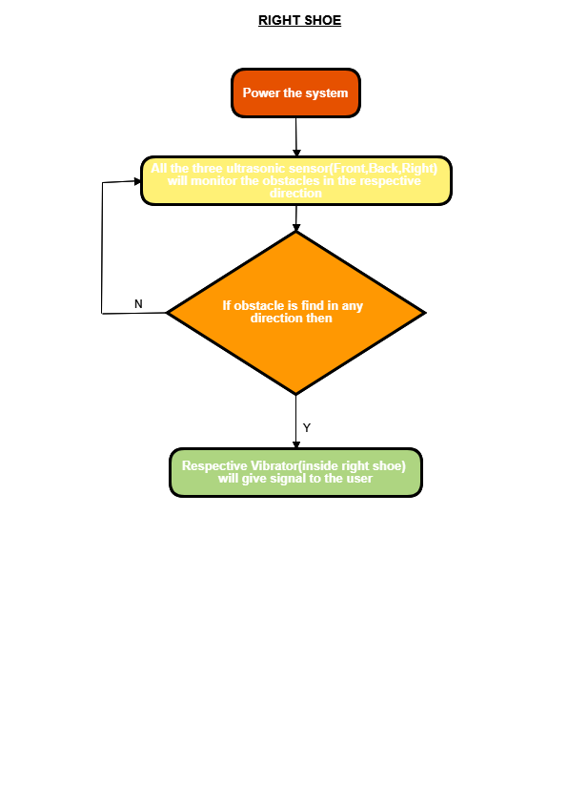
4. FLOW CHART OF RIGHT SHOE

Slide 14
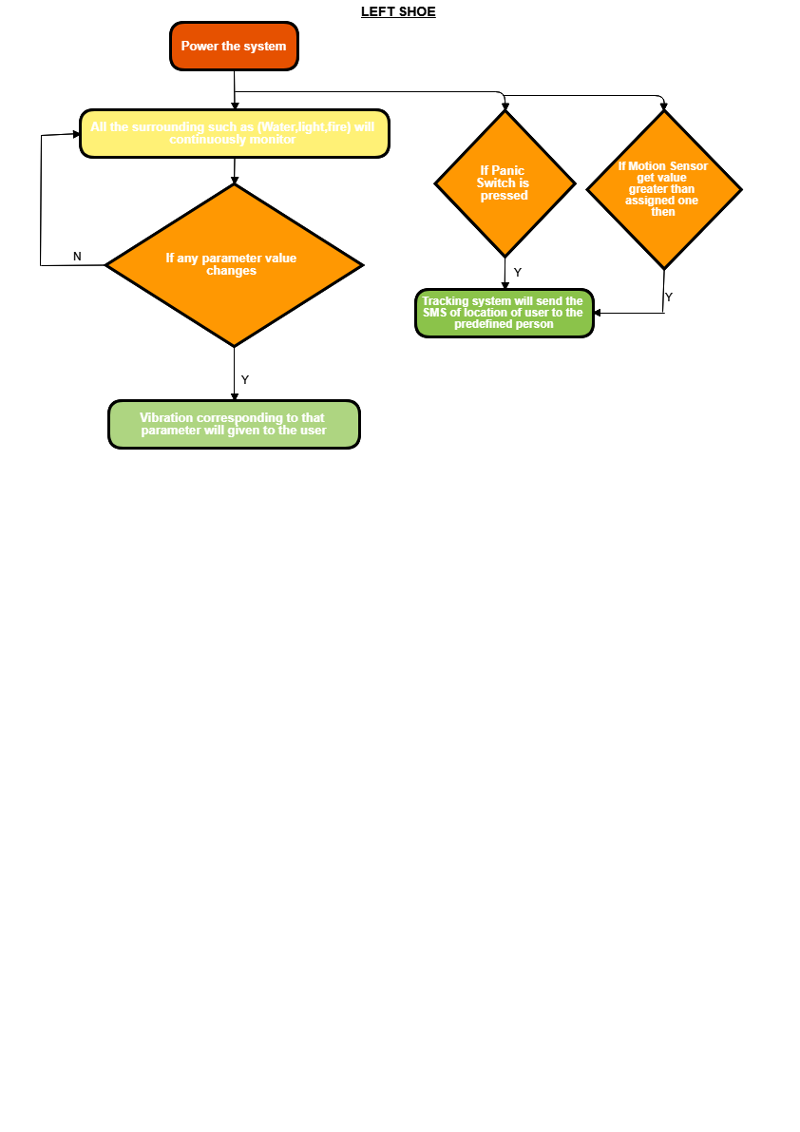
FLOW CHART OF LEFT SHOE

Slide 15
5. STEPS TO USE THE PRODUCT
FOR RIGHT SHOE:-
The first step to use the system is to make sure the battery is fully charged with the shoes then wear the shoe on the right.
The all 3 ultrasonic sensors (front, back, right) will start working and wait for the obstacle. When the obstacle is detected the respective vibrator on the shoe will vibrate and alter the user about the obstacle.

Slide 16
FOR LEFT SHOE:-
The first step to use the system is to make sure the battery is fully charged with the shoes then wear the shoe on left and connect it to Bluetooth of the phone then give the instruction to the Assistance according to our destination location, then the assistance will guide the user according to the destination path by giving proper instruction about the direction.
After that, the system will guide you about the things surrounding to users such as water detection, light intensity, and fire detection and if there is a change in any of the parameter then the vibration to that respective parameter will give to the user left shoe.
The panic system is also get started when the system is power on, so if the user is facing some problem they can press the panic button. So the location of the user is sent to their respective family member and they can track the user.
The motion sensor will also monitor the user motion if there is a change in the motion speed than also the tracking system will start working as the same in the panic system.

Slide 17
6. ADVANTAGES
It provide different vibration feedback as per the surrounding condition can be detected
Auto detection of obstacles
Tracking is possible
Give right path with good accuracy (google assistance)
Easy to carry or wear
Low cost

Slide 18
7. DISADVANTAGES
User has to remember the vibrations for different parameter.

Slide 19
8. FUTURE SCOPE
Future scope will be focused on enhancing the performance of the system and reducing the load on the user by adding the camera to guide for the object detection with its shape and size.
Develops the Assistant using AI(artificial intelligence) for this system.
Introduces the fitness parameter to monitor the user health.

Slide 20
CONCULSION
We propose smart shoes for obstacle detection, navigation along with surrounding condition for visually impaired people.
The processing of data will be done dynamically as the user walks with the sensors activated. The processing of the values will be communicated from the sensors to the Arduino board. This, the complexity and the time will be low and the obstacle and be detected in fraction of seconds.
Thus, with the ease of use and faster response time, a visually impaired person can sense, feel, listen and walk with the environment around him with the help of these Smart Shoes.
For navigation purposes Google maps application in the background with the help of google assistance through Bluetooth.

Slide 21
REFERENCE
[1] S.Gangwar (2013) designed a smart stick for blind which can give early warning of an obstacle using Infrared (IR) sensors, “A Smart Infrared Microcontroller-Based Blind Guidance System”, Hindawi Transactions on Active and Passive Electronic Components,Vol.3, No.2, pp.1-7, June 2013.
[2] S.Chew (2012) proposed the smart white cane, called Blind spot that combines GPS technology, “Electronic Path Guidance for Visually Impaired People”, The International Journal Of Engineering And Science (IJES), Vol.2, No.4, pp.9-12, April 2012.
[3] A. Discant, A. Rogozan, C. Rusu and A. Bensrhair, "Sensors for Obstacle Detection - A Survey," 2007 30th International Spring Seminar on Electronics Technology (ISSE), Cluj-Napoca, 2007, pp. 100-105. doi: 10.1109/ISSE.2007.4432828

Slide 22
[4] Mustapha, Baharuddin, AladinZayegh, and Rezaul K. Begg. "Ultrasonic and infrared sensors performance in a wireless obstacle detection system." Artificial Intelligence, Modelling and Simulation (AIMS), 2013 1st International Conference on. IEEE, 2013.
[5] Mustapha, B., A. Zayegh, and R. K. Begg. "Wireless obstacle detection system for the elderly and visually impaired people." Smart Instrumentation, Measurement and Applications (ICSIMA), 2013 IEEE International Conference on. IEEE, 2013.
[6] Bousbia-Salah, M., Redjati, A., Fezari, M., &Bettayeb, M. (2007, November). An ultrasonic navigation system for blind people. In Signal Processing and Communications, 2007. ICSPC 2007. IEEE International Conference on (pp. 1003-1006). IEEE.
[7] Mahmud, N., Saha, R. K., Zafar, R. B., Bhuian, M. B. H., &Sarwar, S. S. (2014, May). Vibration and voice operated navigation system for visually impaired person. In Informatics, Electronics & Vision (ICIEV), 2014 International Conference on (pp. 1-5). IEEE.

Slide 23
THANK YOU

Slide 24
ANY SUGGESTIONS

